Slide 1
The Best Team
Identifying key variables related to SoNYC node performance
Fangshu Lin, Sunglyoung Kim, Andrew Nell

Slide 2
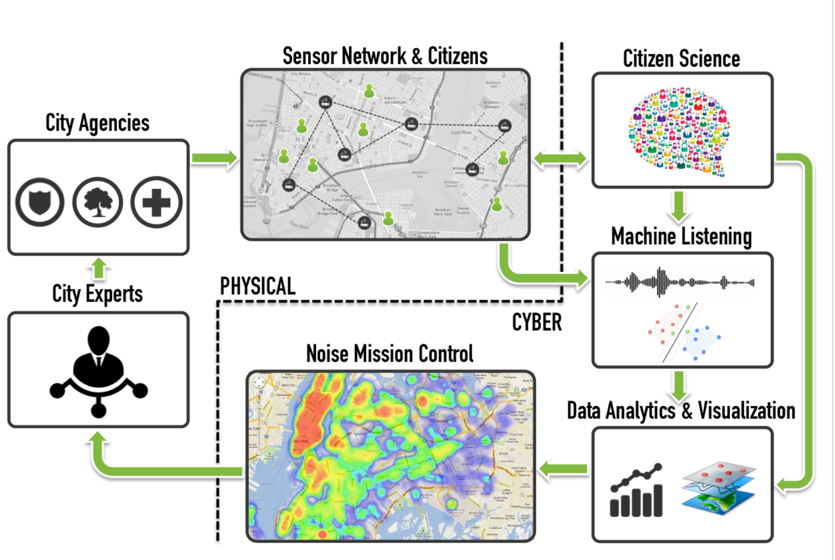
SONYC Overview
SONYC aims to instrument the city with noise measuring nodes for:
Systematic, constant monitoring of noise
Ability to describe acoustic environments and noises
Broadening citizen participation in noise reporting and mitigation
Enabling data driven decision and policy making
Source: Sounds of New York official website - https://wp.nyu.edu/sonyc/

Slide 3
Node performance varies dramatically with nodes often going down, with little understanding of the exact issue
Active
Out of Service
Installation in Progress
Under Construction
Source: Mohit Sharma – email correspondence regarding node performance dashboard

Slide 4
We aim to identify potential correlating measures that are received from the nodes that may assist in identifying issues through Machine Learning
Potential measures to be used to identify issues:
RX and TX Packets (downloading and uploading data)
CPU Load (MHz)
CPU Max and Min Frequency
CPU Temperature (°C)
Memory Usage (Bytes)
Temporary Memory Usage (Bytes)
Sound Pressure level with various aggregations
Number of processes running
Etc.

Slide 5
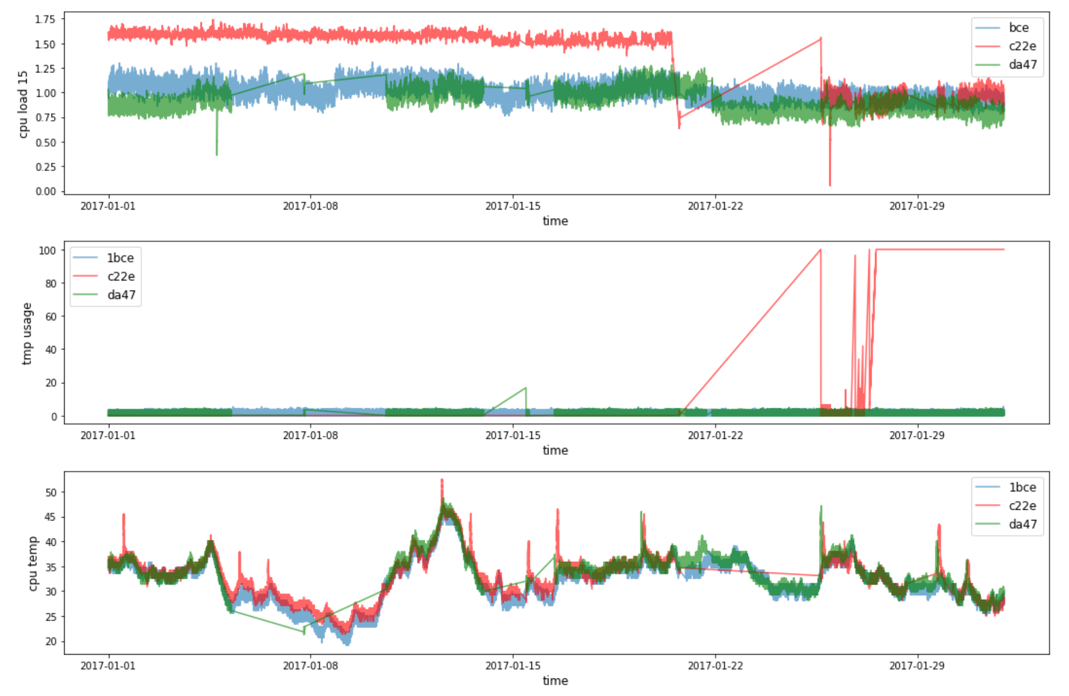
We observed the time series of these factors to monitor performance shifts and identify any leading factors

Slide 6
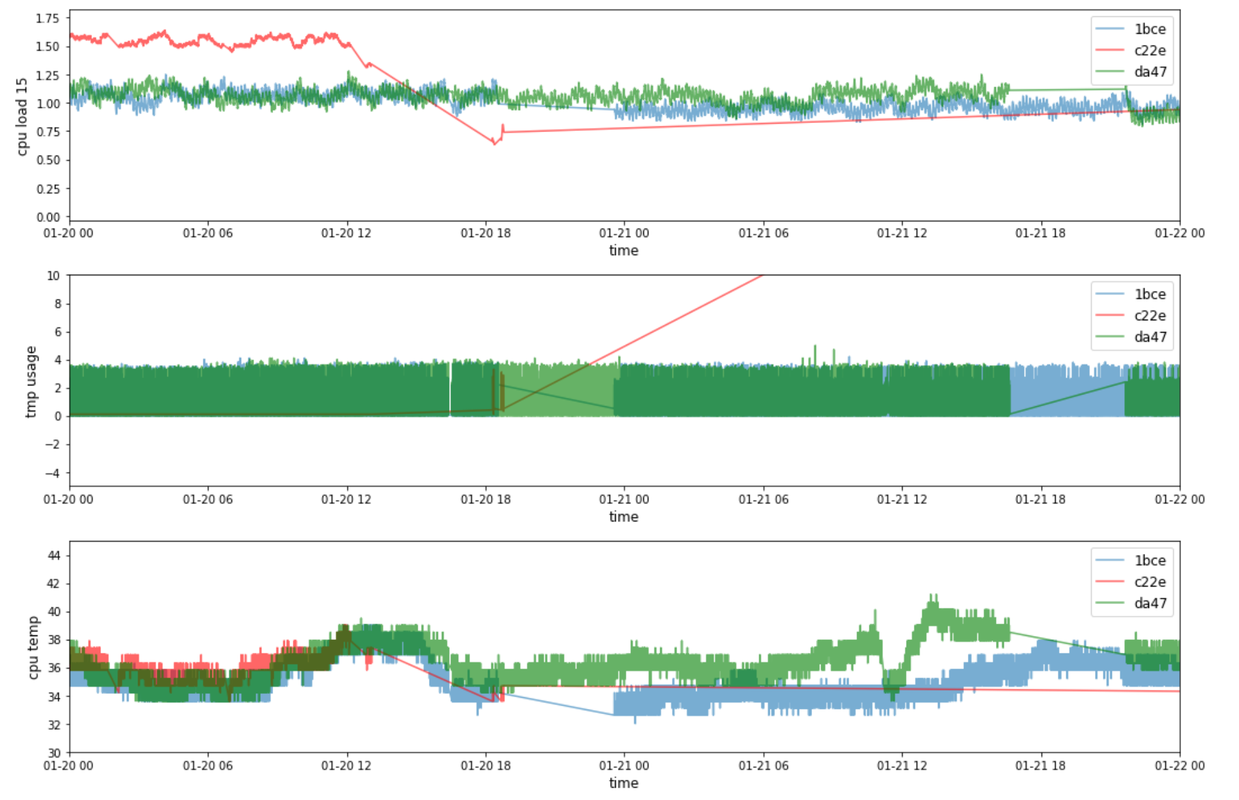
We then pinpointed losses of service and attempted to identify fluctuations in these variables that could be indicators

Slide 7
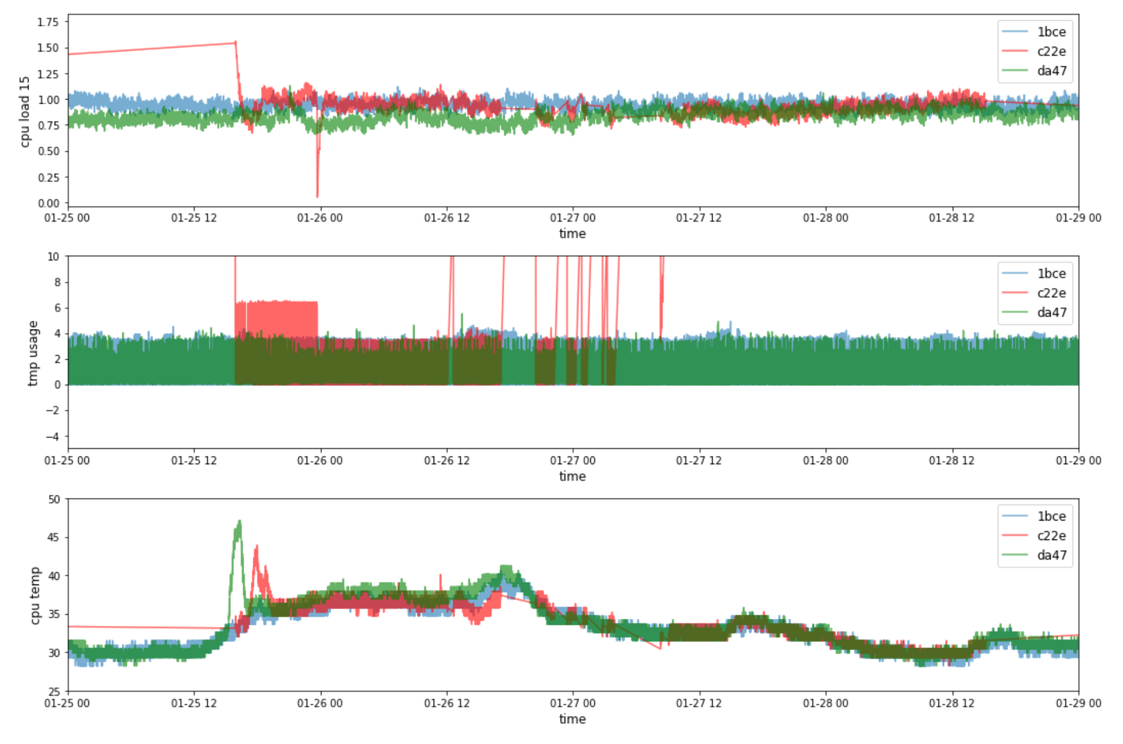
We then pinpointed losses of service and attempted to identify fluctuations in these variables that could be indicators

Slide 8
We identified several key factors that we believe are relevant to monitor
CPU Load (MHz)
Memory Usage (Bytes)
Temporary Memory Usage (Bytes)

Slide 9
There is plenty of work that could have been done with more time and more work for the future
Try and pinpoint specific issues arising due to fluctuations in variables
Using identified issues to develop machine learning monitoring processes to provide alerts when issues are identified
Compare the performance of the nodes with other data sets like weather to monitor the impacts on performance

Slide 10
Carto Demo

